Slide 1
CRCC EXPENSE REPORT
SUMMARY FOR JULY 2023

Slide 3
FISCAL YEAR RECAP (JULY 2022 – JUNE 2023)

Slide 4
73 DELINQUENT ACCOUNTS – TOTAL : $86,574

Slide 6
9 ACCOUNTS REPRESENT 62% OF THE DELINQUENCY

Slide 7
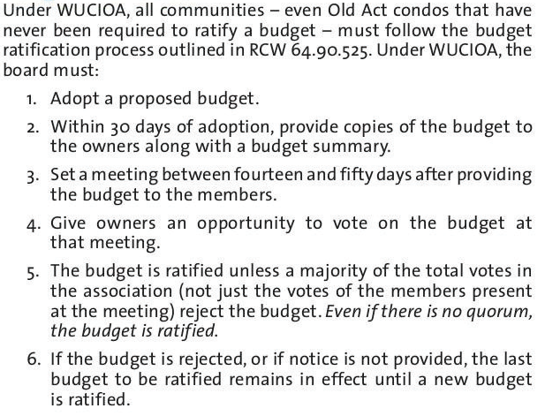
BUDGET ADOPTION AND RATIFICATION PROCESS
RCW LAW vs CRCC BYLAWS

Slide 8
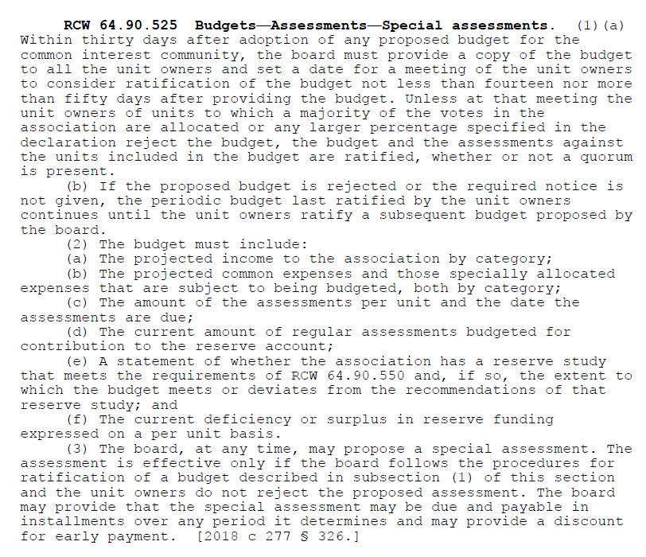

Slide 9
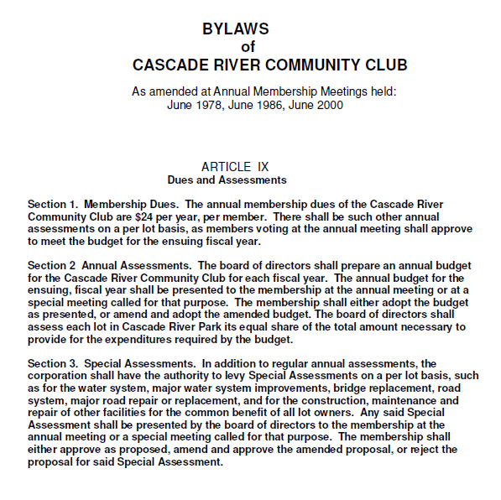

Slide 10
EXAMPLE
Board members present at the budget ratification meeting : 2 out of 5
Results : 40 YES and 60 NO
BEFORE JULY 1st 2018 : Budget NOT ratified (no quorum and more NO)
AFTER JULY 1st 2018 : Budget ratified

Slide 11
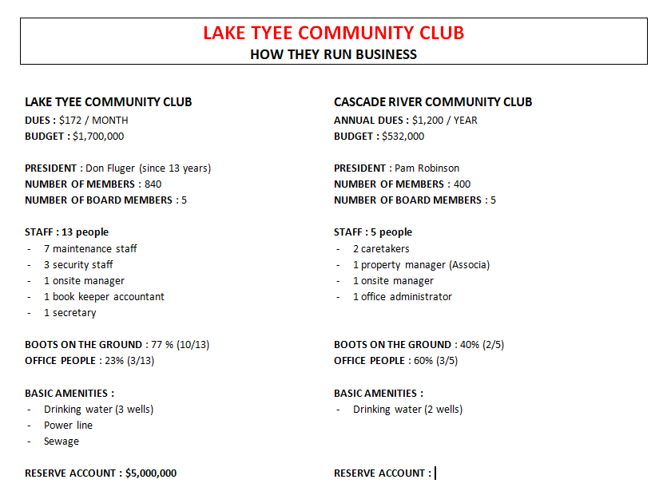

Slide 12
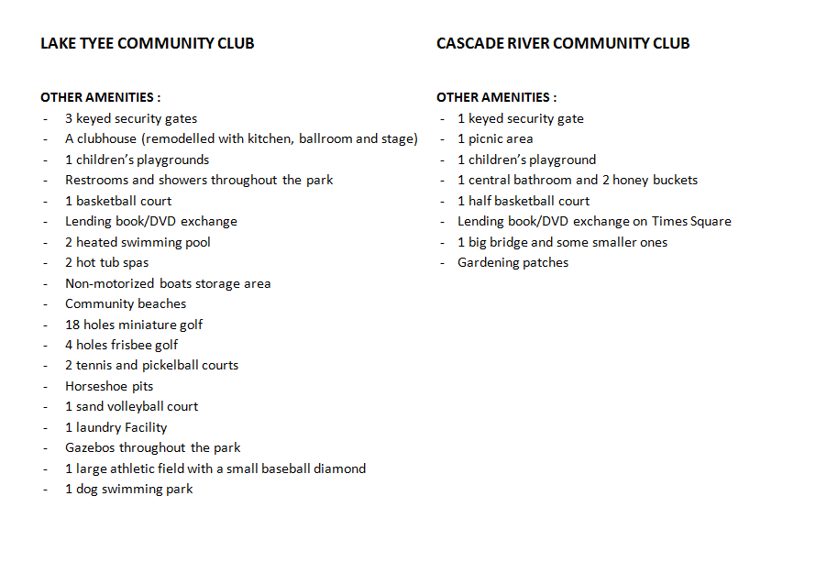

Slide 13
HOW LAKE TYEE COMMUNITY CLUB HAS SOLVED SOME OF THE ISSUES WE ARE FACING
PROPERTY MANAGEMENT COMPANY :
  They had one and concluded it was a rip off and park was falling apart
  Instead they decided for an onsite manager with a precise job description
  They called the membership to vote on the new plan and it was largely approved
BOARD OF DIRECTORS COMMITMENTS :
  Showing once a month is not enough
  Directors have to be available no matter what
  A director does not vote when there is a conflict of interest
DETAILED FINE POLICY :
  Speeding fine
  Abusing staff
  Littering
  Dog off leash
  Call the sherrif if necessary to manage/record an incident
  A member can lose its membership
SHORT TERM RENTAL :
  Guests check-in at the office, get a card for the car and sign the rules and regulations
  Owners take full responsibility and pay the fines if any (CRCC Policy #4450)
  Onsite manager can not manage AirBnb because of conflict of interest

Slide 14
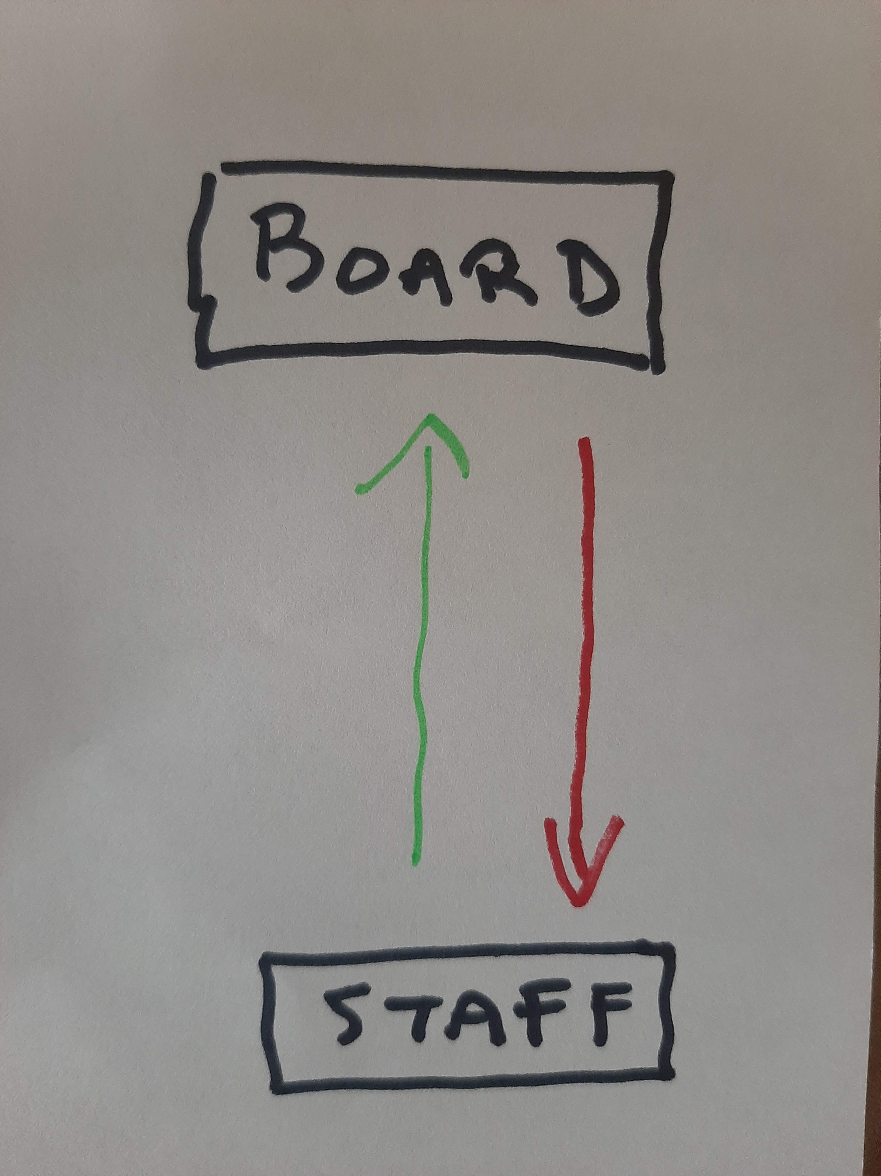
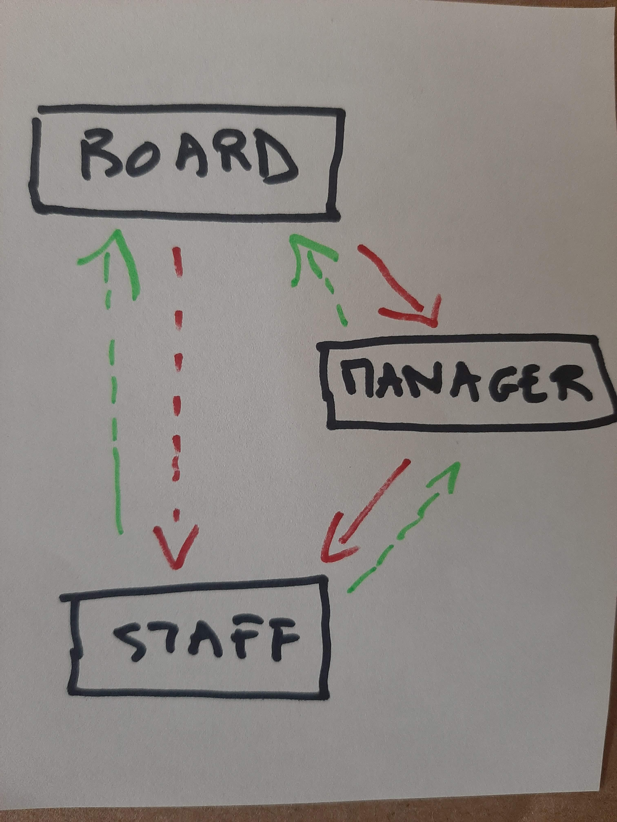
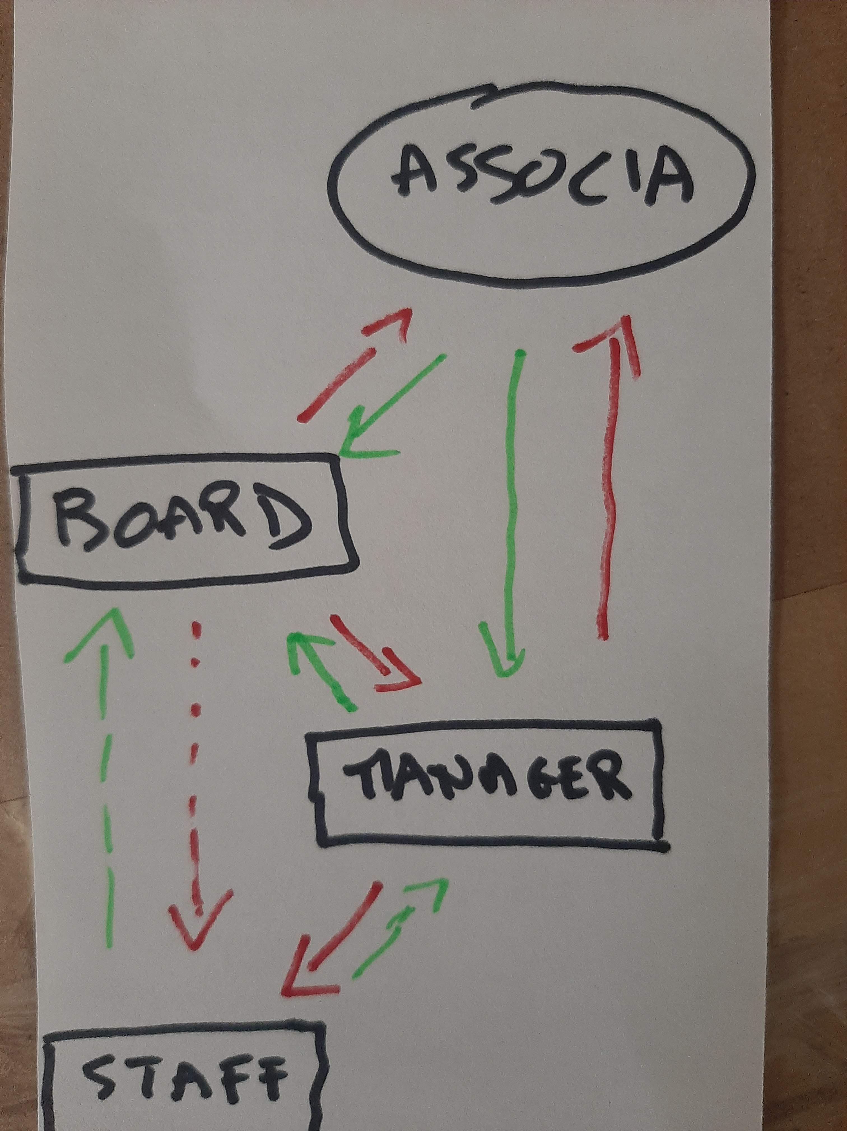
OLD TIME
LAKE TYEE
CRCC

Slide 15

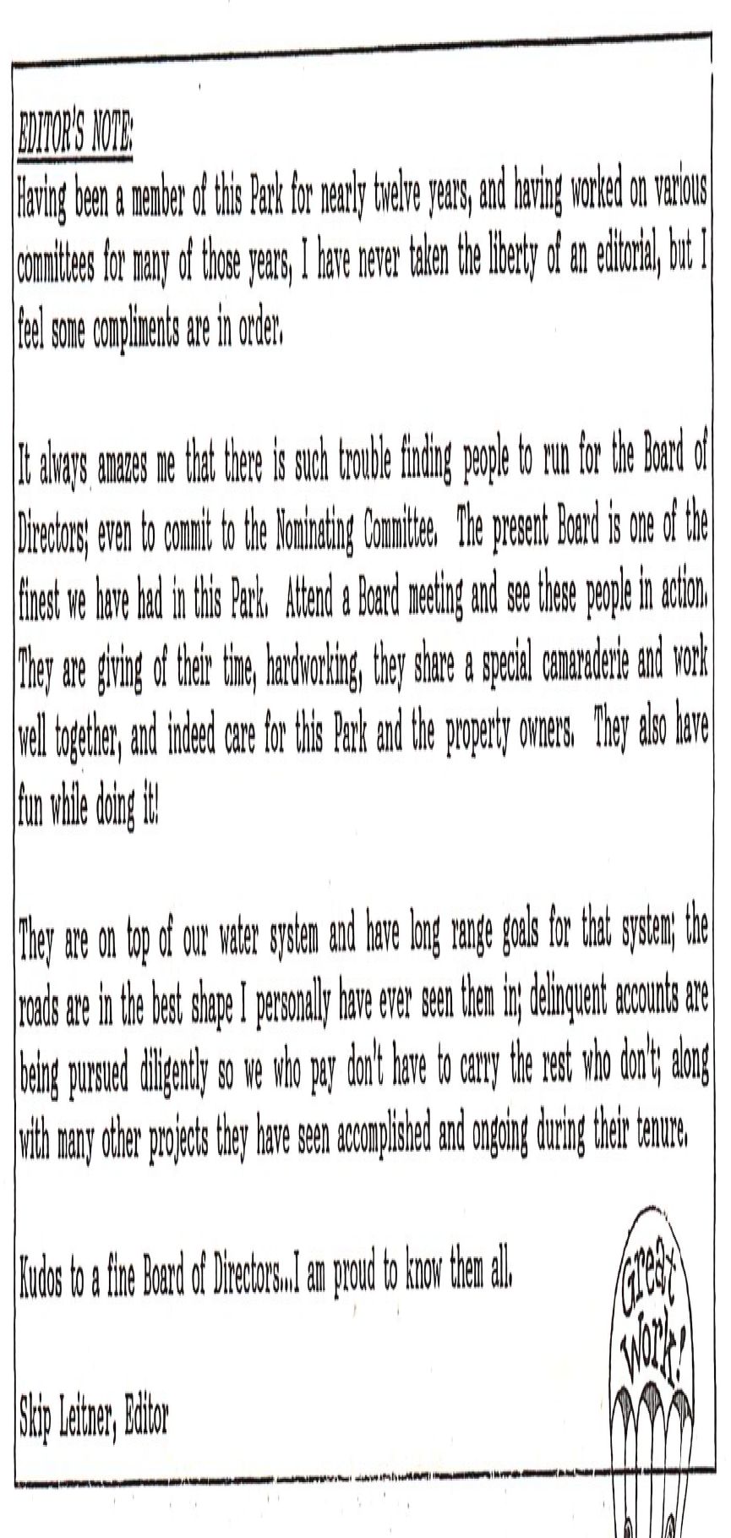
How to reach out directly to the Baord : boardofdirectors@cascaderiverpark.com

